Slide 1
Opening Shop: Exploring locations in Toronto predict where to open a new shop
By: Shreya Gurjar

Slide 2
INTRODUCTION
To help the companies and entrepreneurs that planning to expand their business, open new shops or franchise in Toronto, Canada.
What best shops at certain location ?
Main problem – Best location for new shops, franchise, number of competitors ?
Target audience – companies, entrepreneurs, people who interested to explore the shops

Slide 3
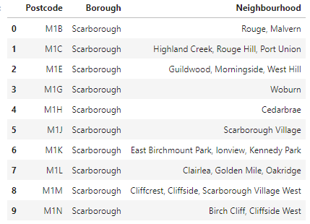
DATA
https://en.wikipedia.org/wiki/List_of_postal_codes_of_Canada:_M

Slide 4
METHODOLOGY
Data Cleaning:
Remove rows containing missing Borough values
Convert missing Neighbourhood values to equal the Borough name
Data Transformation
Combine neighbourhoods by postal code
Add coordinates of postal code to table using the Geocoder API
Use the Foursquare API to gather the venues present in each postal code
Machine Learning Algorithm
K- means clustering

Slide 5
RESULTS

Slide 6
RESULTS cont.

Slide 7
CONCLUSION
In conclusion, this report able to help the companies and entrepreneurs that planning to expand their business, open new shops or franchise in Toronto, Canada.
This will increase the job opportunity and attract many customers to visit.

